Slide 1
Machine Learning

Slide 2
Upon completion of this course, you will be able to:
Master the learning algorithm definition and machine learning process.
Know common machine learning algorithms.
Understand concepts such as hyperparameters, gradient descent, and cross validation.

Slide 3
Machine Learning Definition
Machine Learning Types
Machine Learning Process
Other Key Machine Learning Methods
Common Machine Learning Algorithms
Case study

Slide 4
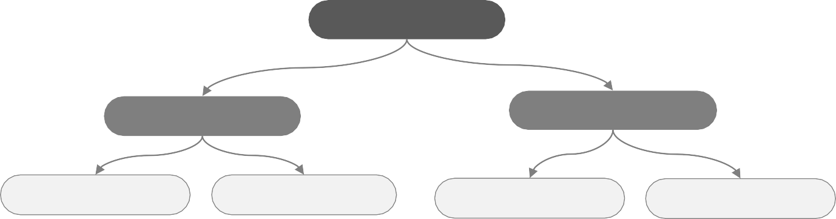
Machine Learning Algorithm Overview
Machine learning
Supervised learning
Unsupervised learning
Classification
Regression
Clustering
Others
Logistic regression
Linear regression
K-means
Correlation rule
SVM
SVM
Hierarchical clustering
Principal component analysis (PCA)
Neural network
Neural network
Density-based clustering
Gaussian mixture model (GMM)
Decision tree
Decision tree
Random forest
Random forest
GBDT
GBDT
KNN
Naive Bayes

Slide 5
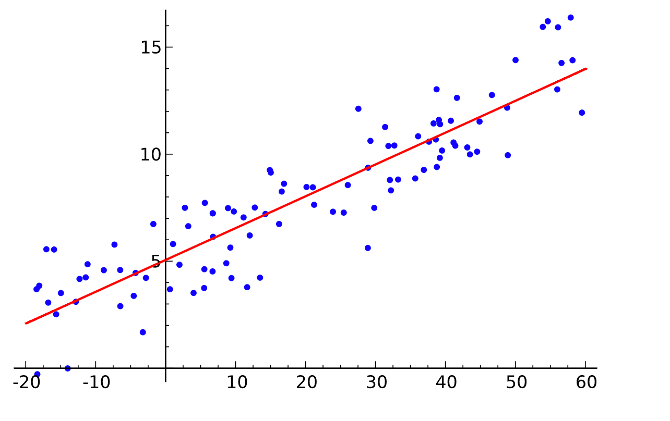
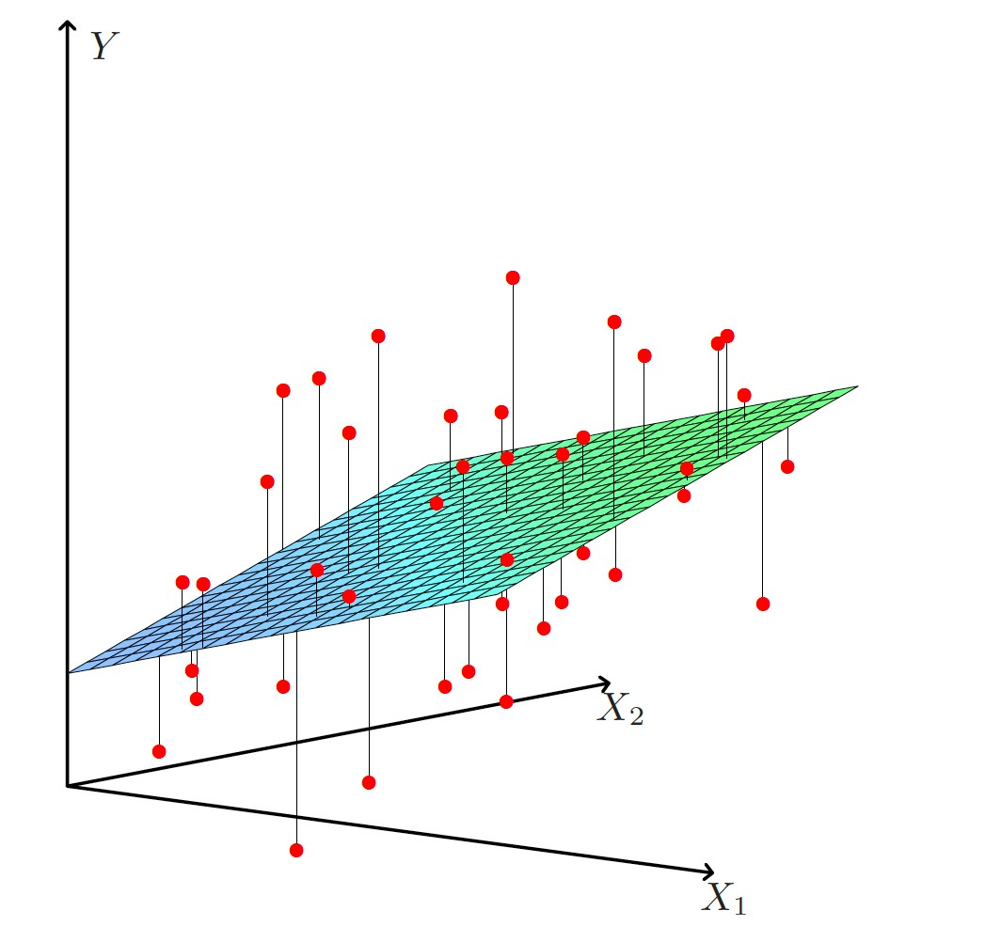
Linear Regression (1)
Linear regression: a statistical analysis method to determine the quantitative relationships between two or more variables through regression analysis in mathematical statistics.
Linear regression is a type of supervised learning.
Unary linear regression
Multi-dimensional linear regression
Notes:
Unary linear regression analysis only involves one independent variable and one dependent variable and their relationship can be approximately represented by a straight line. Multiple linear regression analysis involves two or more independent variables and the relationship between independent variables and dependent variables is linear. The learning result is not necessarily a straight line. It is a straight line only when the variable $x$ is one-dimensional, and it is a hyperplane when the variable is high-dimensional. For example, the price of an apartment is determined by a variety of factors such as the area, layout, and location. Prediction of the apartment price based on these factors can be abstracted into a linear regression problem.
The above figures show polynomial linear regression.

Slide 6
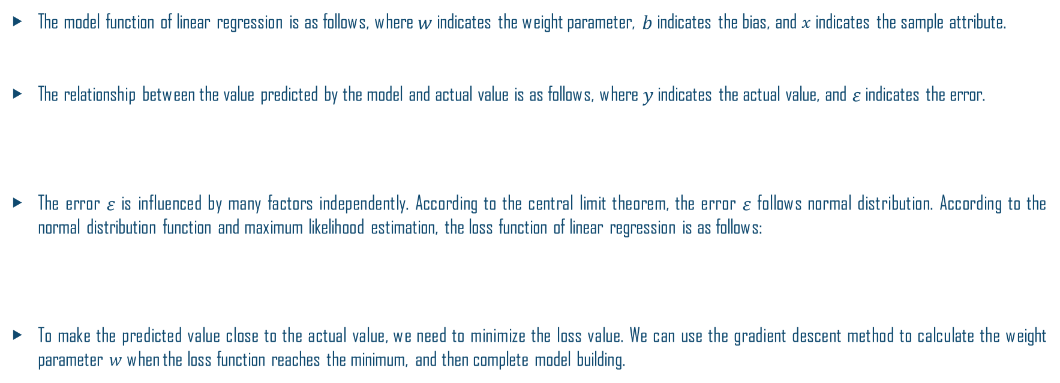
Linear Regression (2)
The model function of linear regression is as follows, where $w$ indicates the weight parameter, $b$ indicates the bias, and $x$ indicates the sample attribute.
The relationship between the value predicted by the model and actual value is as follows, where $y$ indicates the actual value, and $ε$ indicates the error.
The error $ε$ is influenced by many factors independently. According to the central limit theorem, the error $ε$ follows normal distribution. According to the normal distribution function and maximum likelihood estimation, the loss function of linear regression is as follows:
To make the predicted value close to the actual value, we need to minimize the loss value. We can use the gradient descent method to calculate the weight parameter $w$ when the loss function reaches the minimum, and then complete model building.

Slide 7
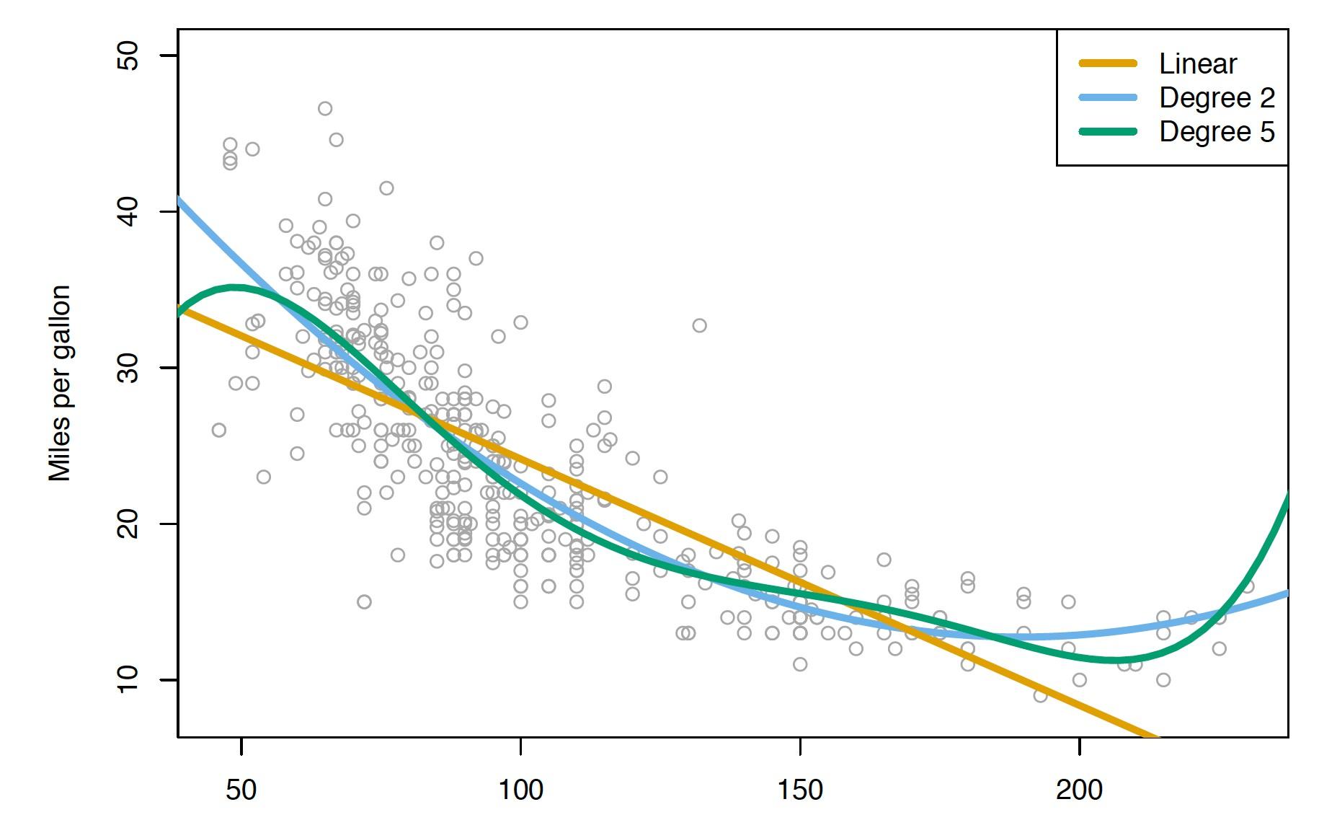
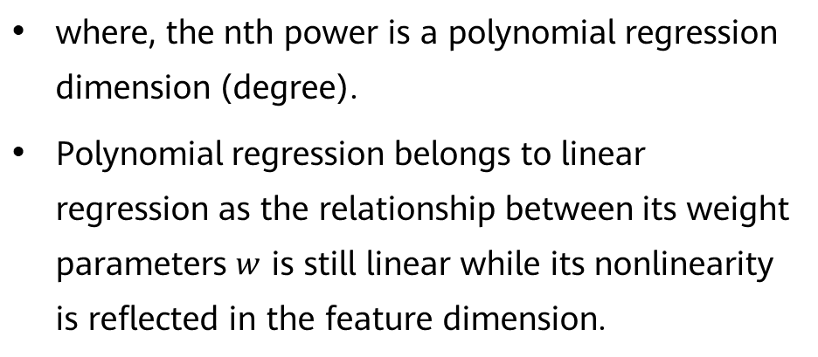
Linear Regression Extension - Polynomial Regression
Polynomial regression is an extension of linear regression. Generally, the complexity of a dataset exceeds the possibility of fitting by a straight line. That is, obvious underfitting occurs if the original linear regression model is used. The solution is to use polynomial regression.
where, the nth power is a polynomial regression dimension (degree).
Polynomial regression belongs to linear regression as the relationship between its weight parameters $w$ is still linear while its nonlinearity is reflected in the feature dimension.
Comparison between linear regression and polynomial regression

Slide 8
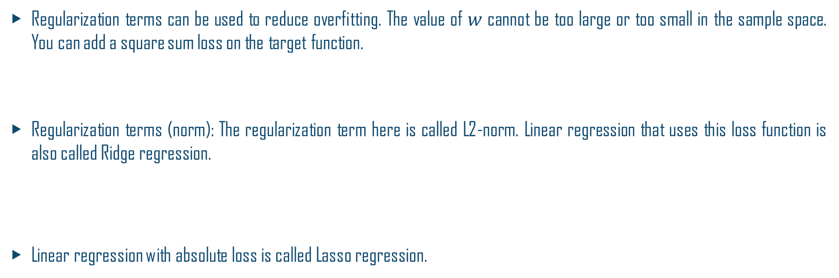
Linear Regression and Overfitting Prevention
Regularization terms can be used to reduce overfitting. The value of $w$ cannot be too large or too small in the sample space. You can add a square sum loss on the target function.
Regularization terms (norm): The regularization term here is called L2-norm. Linear regression that uses this loss function is also called Ridge regression.
Linear regression with absolute loss is called Lasso regression.

Slide 9
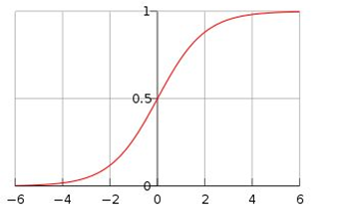
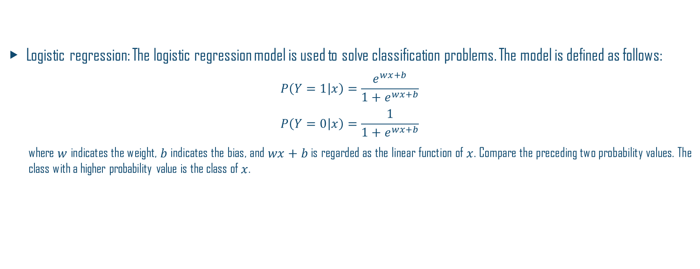
Logistic Regression (1)
Logistic regression: The logistic regression model is used to solve classification problems. The model is defined as follows:
$$P\left(Y=1 | x\right)=\frac{e^{wx+b}}{1+e^{wx+b}}$$
$$P\left(Y=0 | x\right)=\frac{1}{1+e^{wx+b}}$$
where $w$ indicates the weight, $b$ indicates the bias, and $wx+b$ is regarded as the linear function of $x$. Compare the preceding two probability values. The class with a higher probability value is the class of $x$.

Slide 10
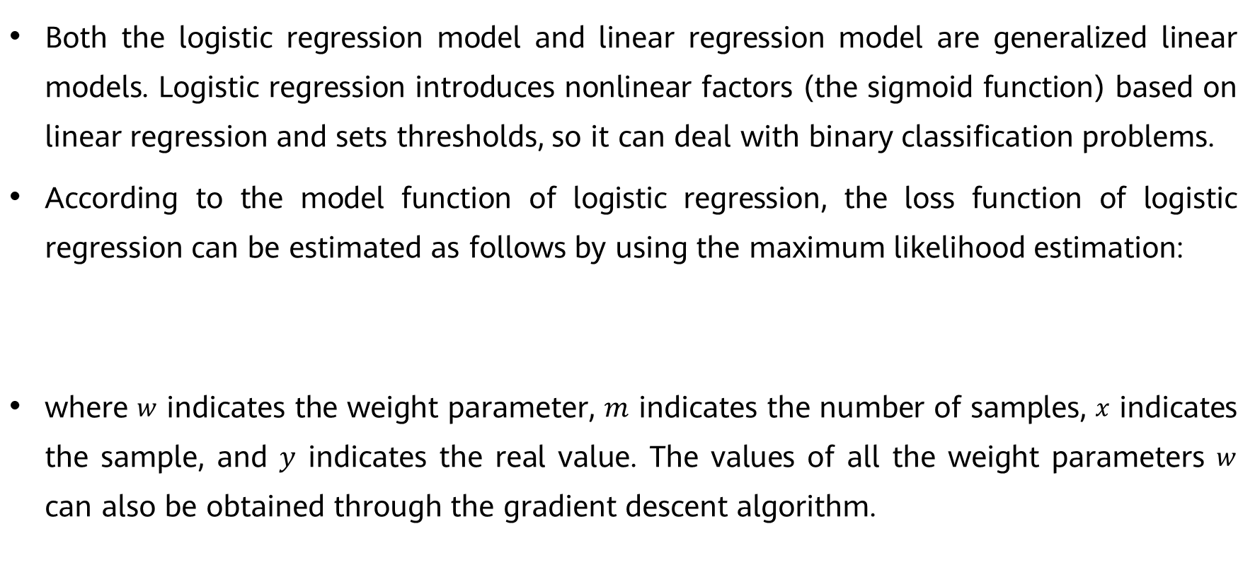
Logistic Regression (2)
Both the logistic regression model and linear regression model are generalized linear models. Logistic regression introduces nonlinear factors (the sigmoid function) based on linear regression and sets thresholds, so it can deal with binary classification problems.
According to the model function of logistic regression, the loss function of logistic regression can be estimated as follows by using the maximum likelihood estimation:
where $w$ indicates the weight parameter, $m$ indicates the number of samples, $x$ indicates the sample, and $y$ indicates the real value. The values of all the weight parameters $w$ can also be obtained through the gradient descent algorithm.
Notes:
After regularization terms are added, logistic regression can also prevent overfitting.

Slide 11








Logistic Regression Extension - Softmax Function (1)
Logistic regression applies only to binary classification problems. For multi-class classification problems, use the Softmax function.
Binary classification problem
Multi-class classification problem
Grape?
Male?
Orange?
Apple?
Female?
Banana?

Slide 12
Logistic Regression Extension - Softmax Function (2)
Softmax regression is a generalization of logistic regression that we can use for K-class classification.
The Softmax function is used to map a K-dimensional vector of arbitrary real values to another K-dimensional vector of real values, where each vector element is in the interval (0, 1).
The regression probability function of Softmax is as follows:

Slide 13

Logistic Regression Extension - Softmax Function (3)
Softmax assigns a probability to each class in a multi-class problem. These probabilities must add up to 1.
Softmax may produce a form belonging to a particular class. Example:
Category
Probability
Grape?
0.09
Sum of all probabilities:
0.09 + 0.22 + 0.68 + 0.01 =1
Most probably, this picture is an apple.
Orange?
0.22
Apple?
0.68
Banana?
0.01

Slide 14
Naïve Bayes classification
Naïve Bayes classifiers assume that the value of a particular feature is independent of the value of any other feature, given the class variable.
For example, a fruit may be considered to be an apple if it is red, round, and about 10 cm in diameter.
Features: Color, roundness, and diameter.
Assumption: Each of these features contributes independently to the probability that this fruit is an apple, regardless of any possible correlations between the color, roundness, and diameter features.
Notes:
Naïve Bayes classifiers is a powerful and simple supervised machine learning algorithm. It assumes that the value of a particular feature is independent of the value of any other feature, given the class variable. For example, a fruit may be considered to be an apple if it is red, round, and about 10 cm in diameter.
Features: Color, roundness, and diameter.
A Naïve Bayes classifier considers each of these features to contribute independently to the probability that this fruit is an apple, regardless of any possible correlations between the color, roundness, and diameter features.

Slide 15
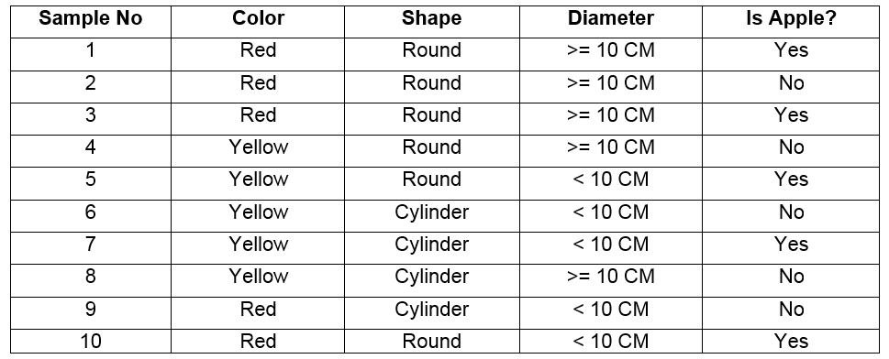
Naïve Bayes classification (cont.)
Example: Use Naïve Bayes to predict whether the Red, Round shaped, 10 cm diameter label is an apple or not.
Notes:
Imagine that you have the data set that is shown in the table in this slide. The column with title “Is Apple?” represents the label of the data. Our objective is to make a new prediction for an unknown object. The unknown object has the following features:
Color: Red
Shape: Round
Diameter: 10 cm
Note 1: Sometimes the terminology “parameters” or “variables” is used to describe the “features”.
Note 2: “Annotated data” or “labeled data” refer to the same terminology.

Slide 16
Naïve Bayes classification (cont.)
To do a classification, you must perform the following steps:
Define two classes (Cy and CN) that correspond to Apple = Yes and Apple = No.
Compute the probability for Cy as x: p(Cy | x): p(Apple = Yes | Colour = Red, Shape = round, Diameter => 10 cm)
Compute the probability for CN as x: p(CN | x): p(Apple = No | Colour = Red, Shape = round, Diameter => 10 cm)
Discover which conditional probability is larger:
If p(Cy |x) > p(CN |x), then it is an apple.
Notes:
Your algorithm basically depends on calculating two probability values:
Class probabilities: The probabilities of having each class in the training data set.
Conditional probabilities: The probabilities of each input feature giving a specific class value.
The process for solving this problem is as follows:
Define two classes CY and CN that correspond to Apple = Yes and Apple = No.
Compute the probability for CY as x: p(CY | x): p(Apple = Yes | Colour = Red, Shape = round, Diameter => 10 cm)
Compute the probability for CN as x: p(CN | x): p(Apple = No | Colour = Red, Shape = round, Diameter => 10 cm)
Discover which conditional probability is larger: If p(CY |x) > p(CN |x), then it is an apple.

Slide 17
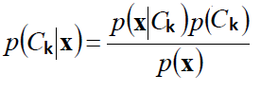
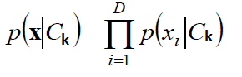
Naïve Bayes classification (cont.)
Naïve Bayes model:
Compute p(x|CY) = p(Colour = Red, Shape = round, Diameter =>10 cm | Apple = Yes). Naïve Bayes assumes that the features of the input data (the apple parameters) are independent.
Notes:
The Naïve Bayes formula is given by this model. Our target is to compute the formula to reach p(CK |x), where K is any class (CY or CN).
Compute the conditional probability of having each feature given that the class is CY: p(x|CY) = p(Colour = Red, Shape = round, Diameter =>10 cm | Apple = Yes).
Because Naïve Bayes assumes that the features of the input data (the object features) are independent, to get the p(x|CY) value, we calculate the conditional probability of each feature at a time with the class CY, and then multiply all the values.

Slide 18
Naïve Bayes classification (cont.)
Thus, we can rewrite p(x| CY) as:
= p(Colour = Red | Apple = Yes) X p(Shape = round | Apple = Yes) X p(Diameter => 10 cm | Apple = Yes)
Same for p(x| CN):
= p(Color = Red | Apple = No) X p(Shape = round | Apple = No) X p(Diameter => 10 cm | Apple = No)
Notes:
Thus, we can rewrite p(x| CY) as:
= p(Colour = Red | Apple = Yes) X p(Shape = round | Apple = Yes) X p(Diameter => 10 cm | Apple = Yes)
We apply the same rule for p(x| CN) by multiplying the conditional probabilities of reach input feature given CN:
= p(Color = Red | Apple = No) X p(Shape = round | Apple = No) X p(Diameter => 10 cm | Apple = No)

Slide 19
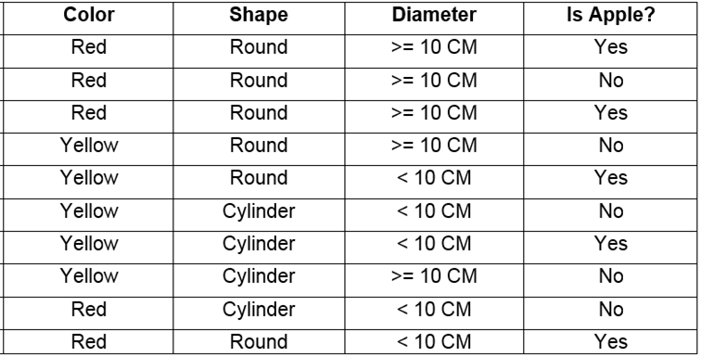
Naïve Bayes classification (cont.)
Calculate each conditional probability:
p(Colour = Red | Apple = Yes) = 3/5 (Out of five apples, three of them were red.) p(Colour = Red | Apple = No) = 2/5 p(Shape = Round | Apple = Yes) = 4/5 p(Shape = Round | Apple = No) = 2/5 p(Diameter = > 10 cm | Apple = Yes) = 2/5 p(Diameter = > 10 cm | Apple = No) = 3/5
Notes:
Let us see how to calculate these conditional probabilities. For example, to calculate p(Colour = Red | Apple = Yes), you are asking, “What is the probability for having a red color object given that we know that it is an apple”.
You browse the table to see how many “is Apple?” has a “yes” label. You see that the occurrence is five times.
Now, from the table, how many of these five occurrences are when you have a color = red? You find that there are three occurrences for red color. Therefore, p(Colour = Red | Apple = Yes) = 3/5.
Repeat these steps for the rest of the features.

Slide 20
Naïve Bayes classification (cont.)
p(Color = Red | Apple = Yes) X p(Shape = round | Apple = Yes) X p(Diameter = > 10 cm | Apple = Yes) = (3/5) x (4/5) x (2/5) = 0.192
p(Color = Red | Apple = No) X p(Shape = round | Apple = No) X p(Diameter = > 10 cm | Apple = No) = (2/5) x (2/5) x (3/5) = 0.096
p(Apple = Yes) = 5/10
p(Apple = No) = 5/10
Notes:
Now, we have all the values that we need. As mentioned in step 5, we multiply the conditional probabilities as follows:
p(Color = Red | Apple = Yes) X p(Shape = round | Apple = Yes) X p(Diameter = > 10 cm | Apple = Yes)
= (3/5) x (4/5) x (2/5) = 0.192
p(Color = Red | Apple = No)p(Shape = round | Apple = No)p(Diameter = > 10 cm | Apple = No)
= (2/5) x (2/5) x (3/5) = 0.096
p(Apple = Yes) = 5/10
p(Apple = No) = 5/10

Slide 21
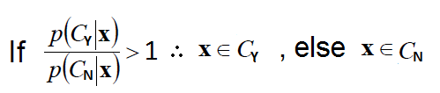
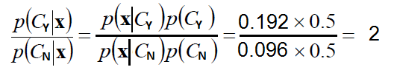
Naïve Bayes classification (cont.)
Compare p(CY | x) to p(CN | x):
Therefore, the verdict is that it is an apple.
Notes:
Finally, we compare the values of p(CY |x) versus p(CN |x). By substituting the values that were calculated in the previous steps, we discover that p(CY |x) > p(CN |x), which means that the object is an apple.

Slide 22
Decision Tree
A decision tree is a tree structure (a binary tree or a non-binary tree). Each non-leaf node represents a test on a feature attribute. Each branch represents the output of a feature attribute in a certain value range, and each leaf node stores a category. To use the decision tree, start from the root node, test the feature attributes of the items to be classified, select the output branches, and use the category stored on the leaf node as the final result.
Root
Short
Tall
Cannot squeak
Can squeak
Short neck
Long neck
Short nose
Long nose
Might be a giraffe
Might be a squirrel
Might be a rat
On land
In water
Might be an elephant
Might be a rhinoceros
Might be a hippo
Notes:
How to construct a decision tree is very important. We should determine the topological structure of feature attributes by selecting attributes based on quantitative values. The key step is to split attributes. That is, different branches are constructed based on the differences of a feature attribute on a node.
The decision tree learning algorithm is used to generate decision trees. Common learning algorithms include ID3, C4.5, and CART.

Slide 23
Decision Tree Structure
Root Node
Internal Node
Internal Node
Leaf Node
Internal Node
Leaf Node
Leaf Node
Leaf Node
Leaf Node
Leaf Node
Notes:
All nodes except the root node are called leaf nodes.

Slide 24
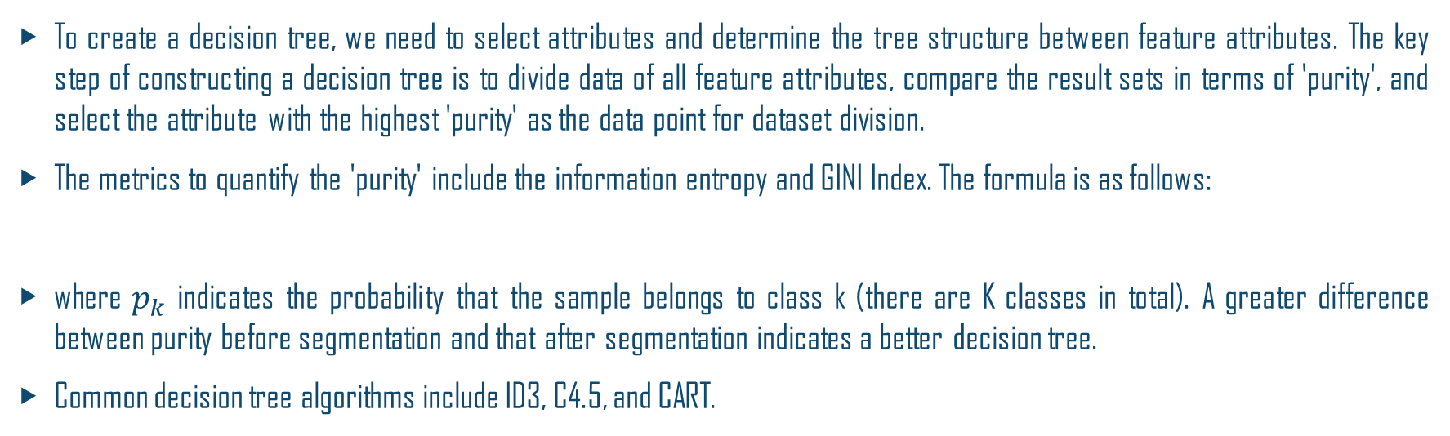
Key Points of Decision Tree Construction
To create a decision tree, we need to select attributes and determine the tree structure between feature attributes. The key step of constructing a decision tree is to divide data of all feature attributes, compare the result sets in terms of 'purity', and select the attribute with the highest 'purity' as the data point for dataset division.
The metrics to quantify the 'purity' include the information entropy and GINI Index. The formula is as follows:
where $p_{k}$ indicates the probability that the sample belongs to class k (there are K classes in total). A greater difference between purity before segmentation and that after segmentation indicates a better decision tree.
Common decision tree algorithms include ID3, C4.5, and CART.

Slide 25
Decision Tree Construction Process
Feature selection: Select a feature from the features of the training data as the split standard of the current node. (Different standards generate different decision tree algorithms.)
Decision tree generation: Generate internal node upside down based on the selected features and stop until the dataset can no longer be split.
Pruning: The decision tree may easily become overfitting unless necessary pruning (including pre-pruning and post-pruning) is performed to reduce the tree size and optimize its node structure.

Slide 26
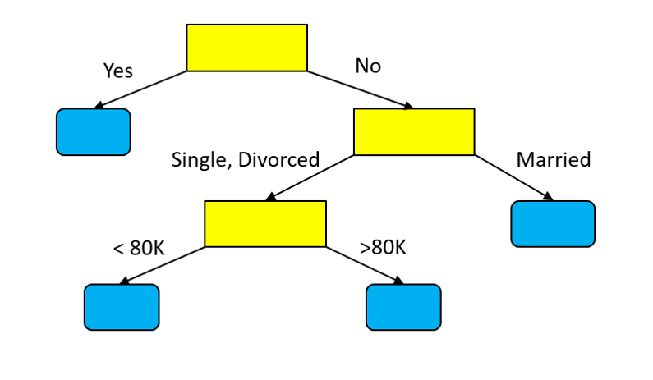
Decision Tree Example
The following figure shows a classification when a decision tree is used. The classification result is impacted by three attributes: Refund, Marital Status, and Taxable Income.
Tid | Refund | Marital Status | Taxable Income | Cheat
1 | Yes | Single | 125,000 | No
2 | No | Married | 100,000 | No
3 | No | Single | 70,000 | No
4 | Yes | Married | 120,000 | No
5 | No | Divorced | 95,000 | Yes
6 | No | Married | 60,000 | No
7 | Yes | Divorced | 220,000 | No
8 | No | Single | 85,000 | Yes
9 | No | Married | 75,000 | No
10 | No | Single | 90,000 | Yes
Refund
No
Marital Status
Taxable
Income
No
No
Yes

Slide 27
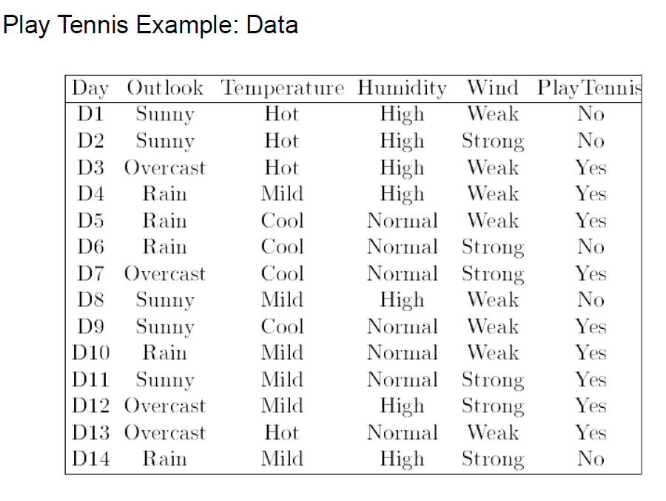
Decision tree (cont.)
Notes:
The “Play Tennis” example is one of the most popular examples to explain decision trees.
In the data set, the label is represented by “PlayTennis”. The features are the rest of the columns: “Outlook”, “Temperature”, “Humidity”, and “Wind”. Our goal here is to predict, based on some weather conditions, whether a player can play tennis or not.
Reference:
Choosing the Best Attribute
http://jmvidal.cse.sc.edu/talks/decisiontrees/choosingbest.html?style=White

Slide 28
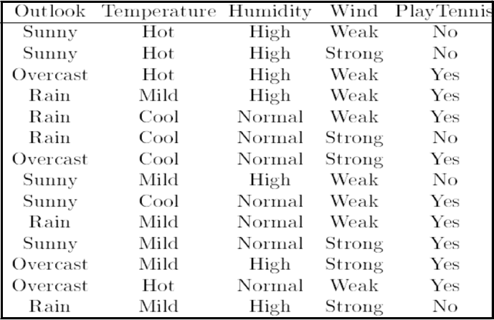
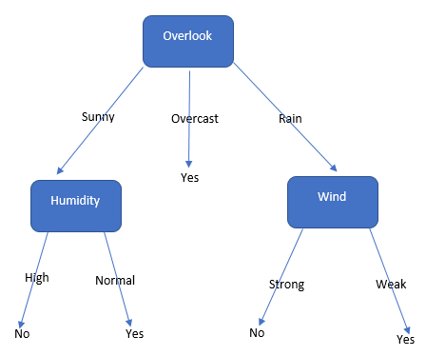
Decision tree (cont.)
Notes:
Back to the example, the decision tree representation on the right side of the figure shows the following information:
Each internal node tests an attribute.
Each branch corresponds to an attribute value.
Each leaf node assigns a classification.
Eventually, we want to make a classification of “if Play Tennis = {Yes, No}”.
Reference:
Choosing the Best Attribute
http://jmvidal.cse.sc.edu/talks/decisiontrees/choosingbest.html?style=White

Slide 29
Decision tree (cont.)
A decision tree is built by making decisions regarding the following items:
Which feature to choose as the root node
What conditions to use for splitting
When to stop splitting
Notes:
The algorithm works by recursively splitting the data based on the value of a feature. After each split, the portion of the data becomes more homogeneous.
Now, the algorithm needs to decide:
Which feature to choose as the root node.
What conditions to use for splitting.
When to stop splitting.

Slide 30
Decision tree (cont.)
Using entropy and information gain to construct a decision tree.
Entropy: It is the measure of the amount of uncertainty and randomness in a set of data for the classification task.
Information gain: It is used for ranking the attributes or features to split at given node in the tree.
Information gain = (Entropy of distribution before the split)–(entropy of distribution after it)
Notes:
The Iterative Dichotomiser3 (ID3) algorithm works by using entropy and information gain to construct a decision tree. Entropy is the measure of the amount of uncertainty and randomness in a set of data for the classification task. Entropy is maximized when all points have equal probabilities. If entropy is minimal, it means that the attribute or feature appears close to one class and has a good discriminatory power for classification.
Entropy zero means that there is no randomness for this attribute.
Information gain is a metric that is used for ranking the attributes or features to split at given node in the tree. It defines how much information a feature provides about a class. The feature with the highest information gain is used for the first split.

Slide 31
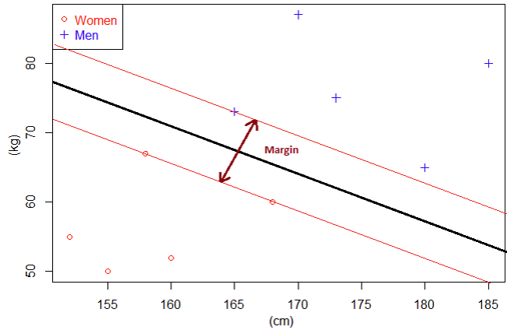
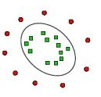
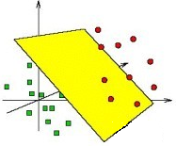
SVM
SVM is a binary classification model whose basic model is a linear classifier defined in the eigenspace with the largest interval. SVMs also include kernel tricks that make them nonlinear classifiers. The SVM learning algorithm is the optimal solution to convex quadratic programming.
weight
Projection
Complex segmentation in low-dimensional space
Easy segmentation in high-dimensional space
height
Notes:
The main ideas of SVM include two points:
In the case of linear inseparability, non-linear mapping algorithms are used to convert the linearly inseparable samples of low-dimensional input space into high-dimensional eigenspace. In this way, samples are linearly separable. Then the linear algorithm can be used to analyze the non-linear features of samples.
Based on the structural risk minimization principle, an optimal hyperplane is constructed in the eigenspace, so that the learner is optimized globally, and the expectation of the whole sample space satisfies an upper boundary with a certain probability.

Slide 32
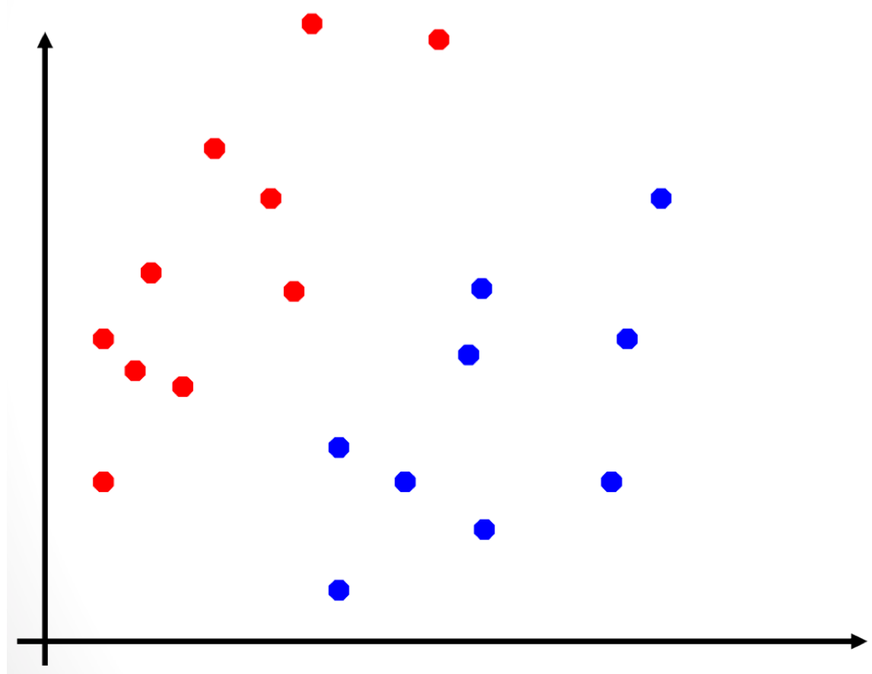
Linear SVM (1)
How do we split the red and blue datasets by a straight line?
or
With binary classification
Two-dimensional dataset
Both the left and right methods can be used to divide datasets. Which of them is correct?

Slide 33
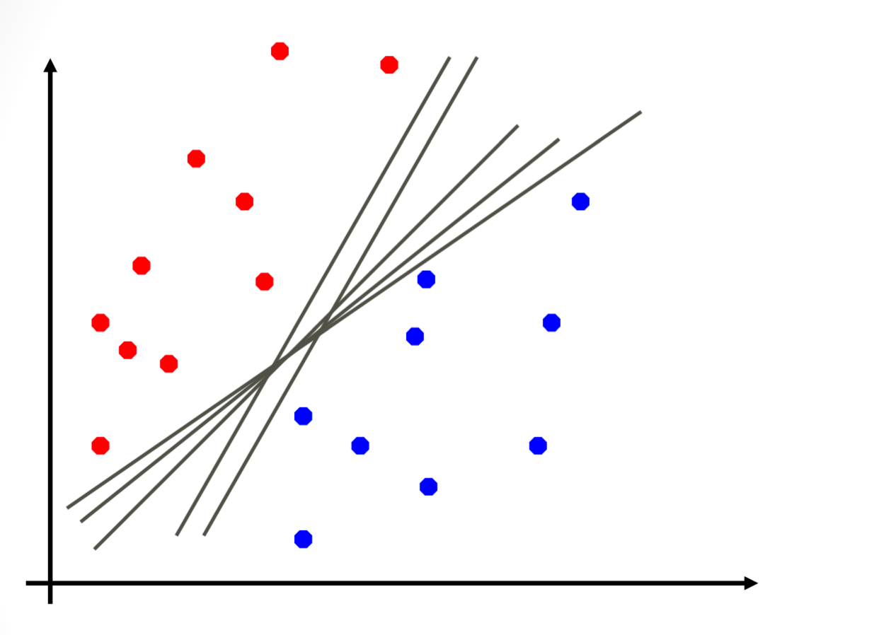
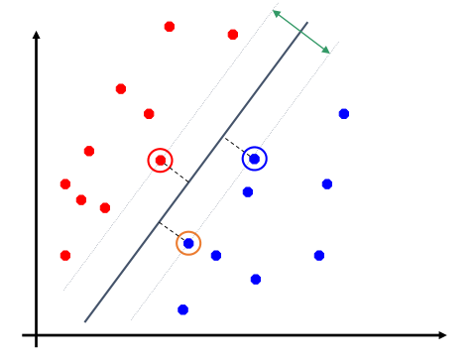
Linear SVM (2)
Straight lines are used to divide data into different classes. Actually, we can use multiple straight lines to divide data. The core idea of the SVM is to find a straight line and keep the point close to the straight line as far as possible from the straight line. This can enable strong generalization capability of the model. These points are called support vectors.
In two-dimensional space, we use straight lines for segmentation. In high-dimensional space, we use hyperplanes for segmentation.
Distance between support vectors
is as far as possible

Slide 34
Nonlinear SVM (1)
How do we classify a nonlinear separable dataset?
Linear SVM can function well for linear separable datasets.
Nonlinear datasets cannot be split with straight lines.

Slide 35
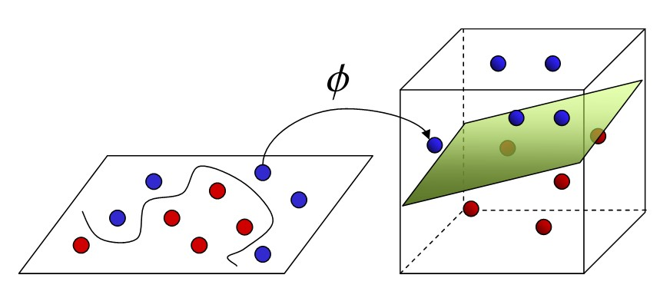
Nonlinear SVM (2)
Kernel functions are used to construct nonlinear SVMs.
Kernel functions allow algorithms to fit the largest hyperplane in a transformed high-dimensional feature space.
Common kernel functions
Linear kernel function
Polynomial kernel function
Gaussian kernel function
Sigmoid kernel function
Input space
High-dimensional feature space
Notes:
Gaussian kernel functions are most frequently used.

Slide 36
KNN Algorithm (1)
The KNN classification algorithm is a theoretically mature method and one of the simplest machine learning algorithms. According to this method, if the majority of k samples most similar to one sample (nearest neighbors in the eigenspace) belong to a specific category, this sample also belongs to this category.
?
The target category of point ? varies with the number of the most adjacent nodes.

Slide 37
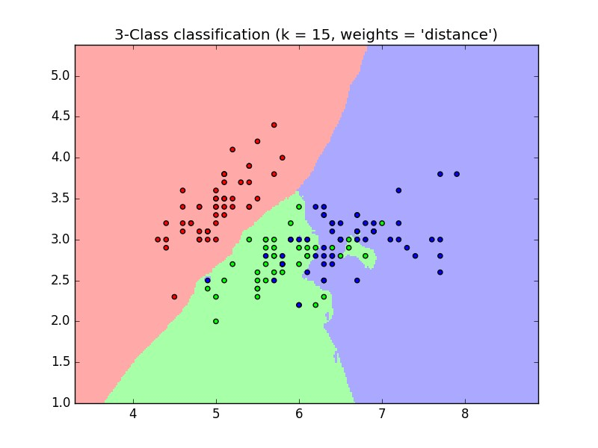
KNN Algorithm (2)
As the prediction result is determined based on the number and weights of neighbors in the training set, the KNN algorithm has a simple logic.
KNN is a non-parametric method which is usually used in datasets with irregular decision boundaries.
The KNN algorithm generally adopts the majority voting method for classification prediction and the average value method for regression prediction.
KNN requires a huge number of computations.

Slide 38
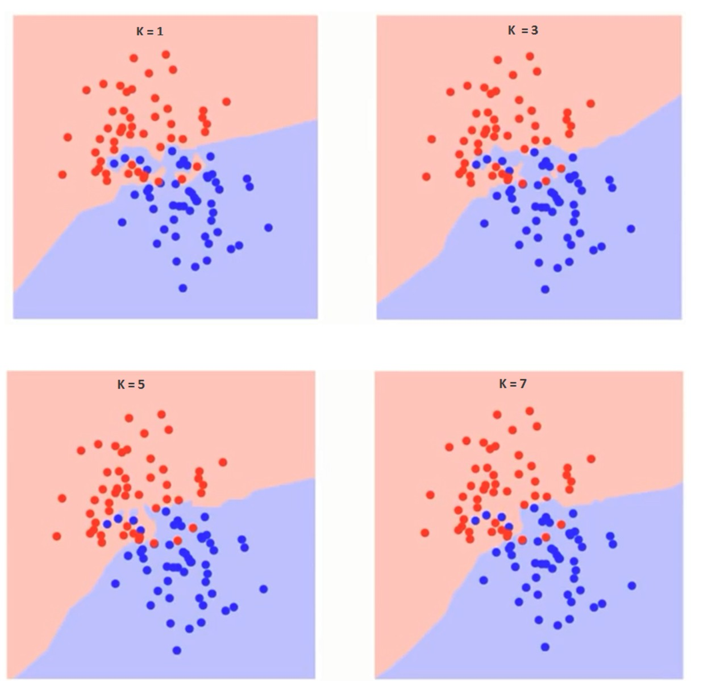
KNN Algorithm (3)
Generally, a larger k value reduces the impact of noise on classification, but obfuscates the boundary between classes.
A larger k value means a higher probability of underfitting because the segmentation is too rough. A smaller k value means a higher probability of overfitting because the segmentation is too refined.
The boundary becomes smoother as the value of k increases.
As the k value increases to infinity, all data points will eventually become all blue or all red.

Slide 39
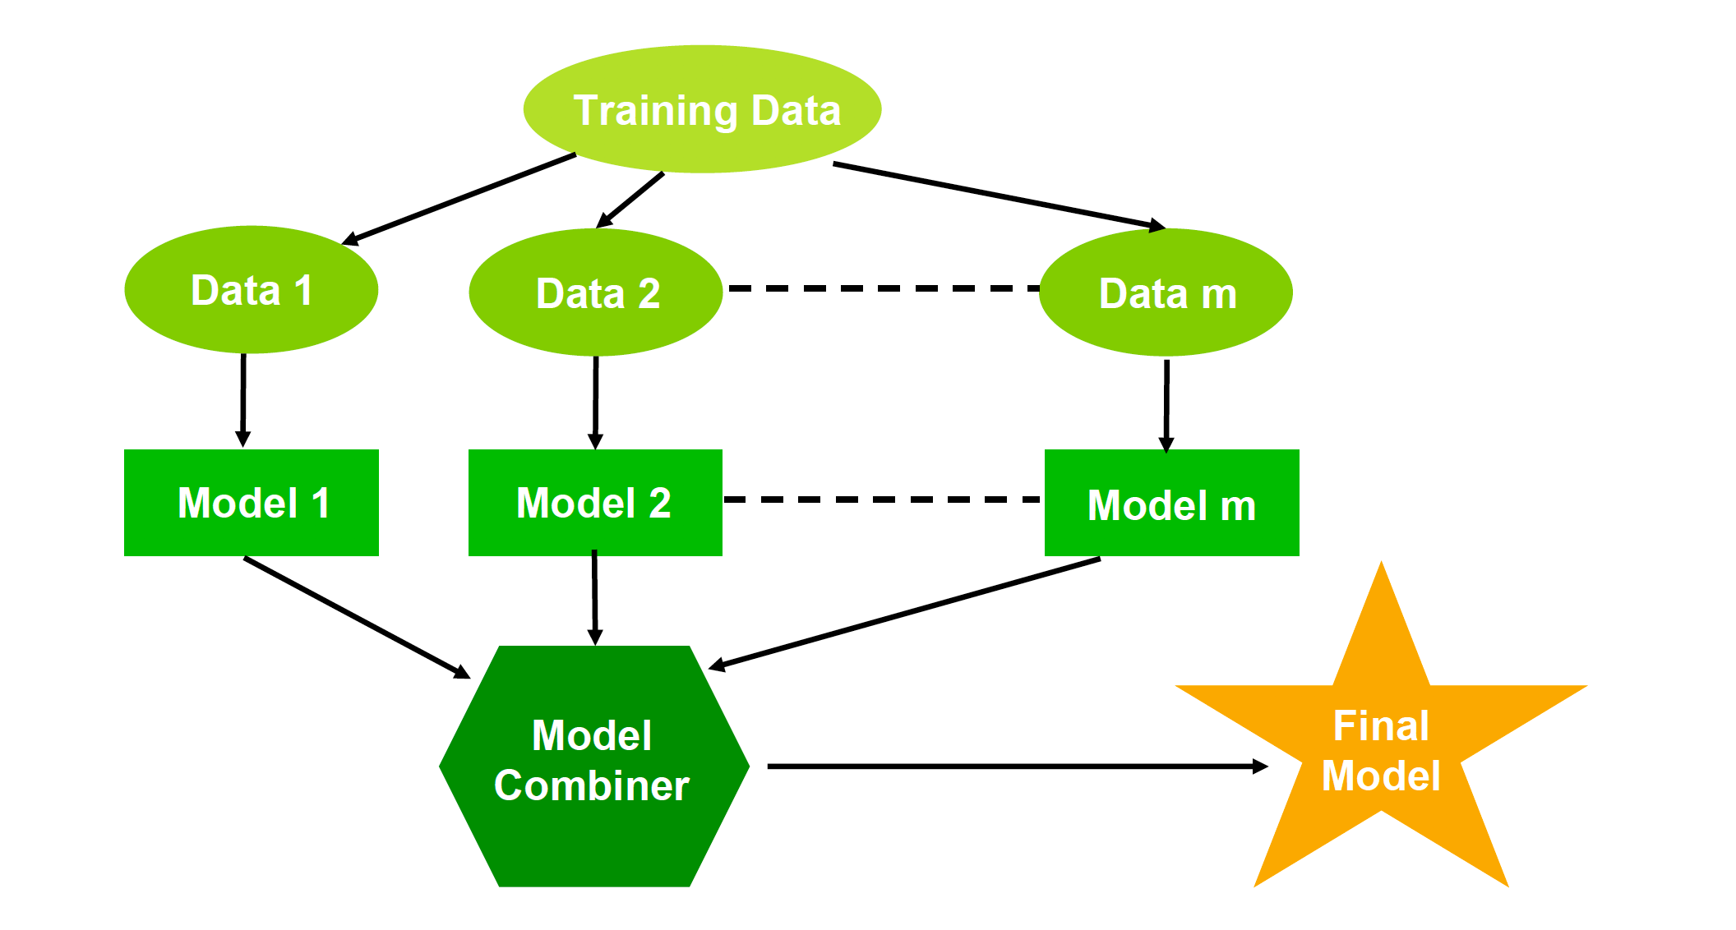
Ensemble Learning
Ensemble learning is a machine learning paradigm in which multiple learners are trained and combined to solve the same problem. When multiple learners are used, the integrated generalization capability can be much stronger than that of a single learner.
If you ask a complex question to thousands of people at random and then summarize their answers, the summarized answer is better than an expert's answer in most cases. This is the wisdom of the masses.
Training set
Dataset 1
Dataset 2
Dataset m
Model 1
Model 2
Model m
Model synthesis
Large model

Slide 40



Classification of Ensemble Learning
Bagging (Random Forest)
Independently builds several basic learners and then averages their predictions.
On average, a composite learner is usually better than a single-base learner because of a smaller variance.
Bagging
Ensemble learning
Boosting (Adaboost, GBDT, and XGboost)
Constructs basic learners in sequence to gradually reduce the bias of a composite learner. The composite learner can fit data well, which may also cause overfitting.
Boosting

Slide 41
Ensemble Methods in Machine Learning (1)
Random forest = Bagging + CART decision tree
Random forests build multiple decision trees and merge them together to make predictions more accurate and stable.
Random forests can be used for classification and regression problems.
Bootstrap sampling
Decision tree building
Aggregation prediction result
Data subset 1
Prediction 1
Data subset 2
Prediction 2
Category: majority voting
All training data
Final prediction
Regression: average value
Prediction
Data subset
Prediction n
Notes:
The Bootstrap bagging method is based on repeatable random sampling.

Slide 42
Ensemble Methods in Machine Learning (2)
GBDT is a type of boosting algorithm.
For an aggregative mode, the sum of the results of all the basic learners equals the predicted value. In essence, the residual of the error function to the predicted value is fit by the next basic learner. (The residual is the error between the predicted value and the actual value.)
During model training, GBDT requires that the sample loss for model prediction be as small as possible.
30 years old
Prediction
20 years old
Residual calculation
Prediction
9 years old
10 years old
Residual calculation
Prediction
1 year old
1 year old

Slide 43
Unsupervised Learning - K-means
K-means clustering aims to partition n observations into k clusters in which each observation belongs to the cluster with the nearest mean, serving as a prototype of the cluster.
For the k-means algorithm, specify the final number of clusters (k). Then, divide n data objects into k clusters. The clusters obtained meet the following conditions: (1) Objects in the same cluster are highly similar. (2) The similarity of objects in different clusters is small.
x1
x1
K-means clustering
The data is not tagged. K-means clustering can automatically classify datasets.
x2
x2

Slide 44
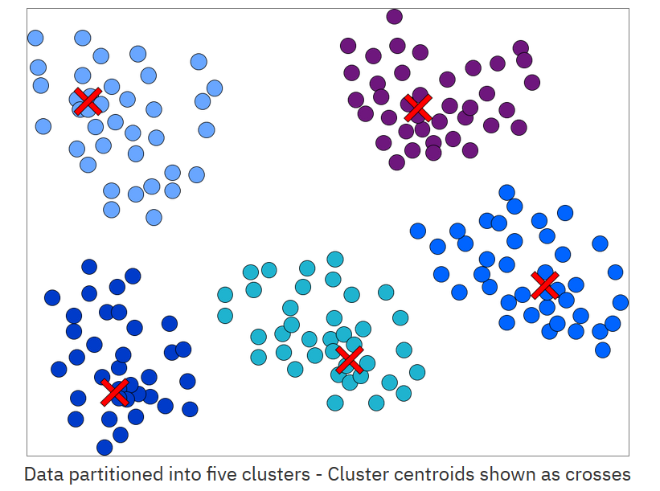
K-mean clustering
Unsupervised machine learning algorithm.
It groups a set of objects in such a way that objects in the same group (called a cluster) are more similar to each other than those in other groups (other clusters).
Notes:
K-means clustering is an unsupervised machine learning technique. The main goal of the algorithm is to group the data observations into k clusters, where each observation belongs to the cluster with the nearest mean.
A cluster’s center is the centroid. The figure shown plots of the partition of a data set into five clusters, with the cluster centroids shown as crosses.

Slide 45
K-means clustering (cont.)
Examples for applications include customer segmentation, image segmentation, and recommendation systems.
Notes:
Examples of applications include:
Customer segmentation: Imagine that you are the owner of electronics store. You want to understand preferences of your clients to expand your business. It is not possible to look at each client’s purchase details to find a good marketing strategy. But, you can group the details into, for example, five groups based on their purchasing habits. Then, you start building your marketing strategy for each group.
Image segmentation and compression: The process of partitioning a digital image into multiple segments (sets of pixels) to simplify and change the representation of an image into something that is more meaningful and easier to analyze. To achieve this task, we need a process that assigns a label to every pixel in an image such that pixels with the same label share certain features. The image in this slide is segmented and compressed into three regions by using k-means clustering. With smaller number of clusters, it provides more image compression but at the expense of less image quality.
Recommendation systems: These systems help you find users with the same preferences to build better recommendation systems.
References:
https://www.mathworks.com/help/examples/images/win64/SegmentGrayscaleImageUsingKMeansClusteringExample_02.png https://www.mathworks.com/help/examples/images/win64/SegmentGrayscaleImageUsingKMeansClusteringExample_01.png

Slide 46
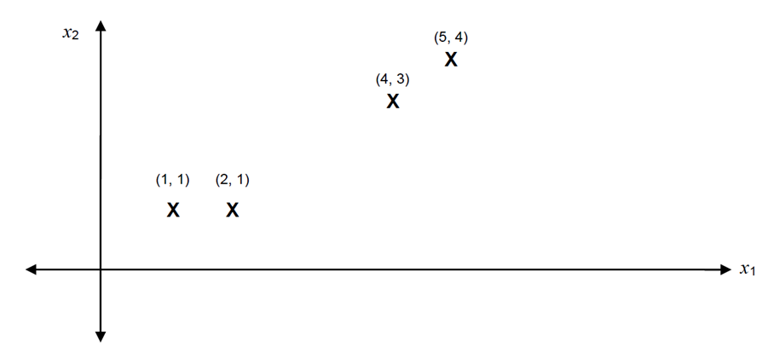
K-means clustering (cont.)
Example: Given the following data points, use K-means clustering to partition data into two clusters.
Notes:
Assume that you have the data points that are show in the figure. Your goal is to cluster each data point into one of two groups. Thus, the cluster size is 2. C1 and C2 represent these two clusters.

Slide 47
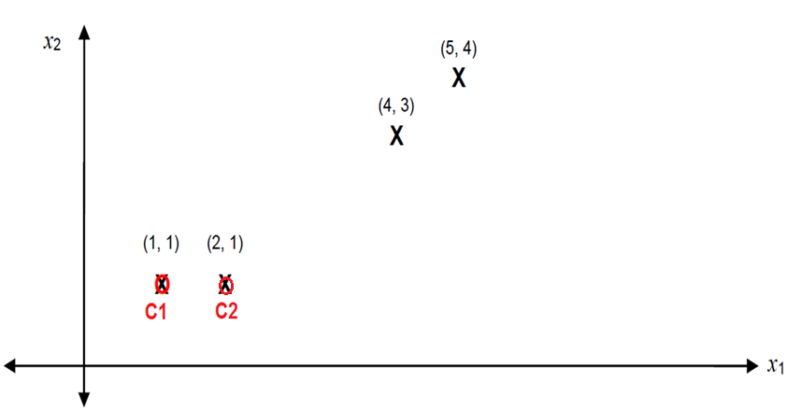
K-means clustering (cont.)
Set initial centroids are C1 (1,1) and C2 (2,1)
Notes:
Assume initial centroids are C1, point (1,1) and C2, point (2,1)

Slide 48
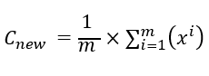
K-means clustering (cont.)
Find a new centroid by using→
Iteration 1:
Now, we calculate for each point to which center it belongs. The result depends on the distance between the center and the point (by using Euclidian distance):
Point 1: (1, 1) → d11 = Yes d12 = No
This means point1(2,2) belongs to C1 and not C2 because it is closer to C1.
Point 2: (2, 1) → d21 = No, d22 = Yes
Point 3: (4, 3) → d31 = No, d32 = Yes
Point 4: (5, 4) → d41 = No, d42 = Yes
Now, we calculate the new centroid as follows:
C1 = (1, 1)
C2 = 1/3 ((2, 1) + (4, 3) + (5, 4)) = (3.67, 2.67)
Notes:
To compute the centroid of a cluster, use an iterative process where each point is examined and you determine whether it belongs to a specific cluster. Then, you compute the new centroid by using the mean of all points.

Slide 49
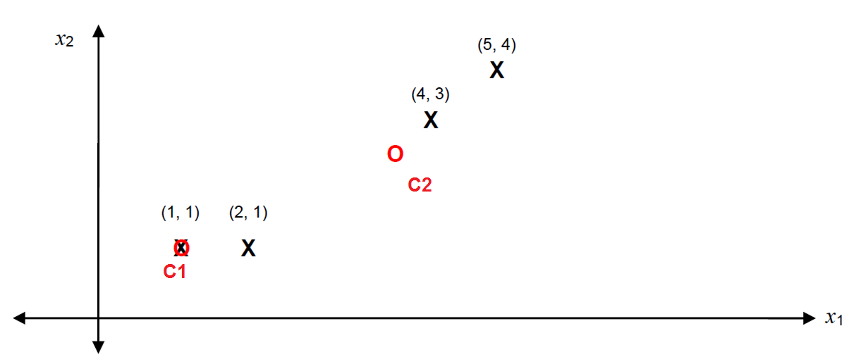
K-means clustering (cont.)
Notes:
As you see, the new points in red are the new centroids. We apply another iteration to find a better centroid that represents each cluster.

Slide 50
K-means clustering (cont.)
Iteration 2:
Point 1: (1, 1) → d11 = Yes, d12 = No
Point 2: (2, 1) → d21 = Yes, d22 = No
Point 3: (4, 3) → d31 = No, d32 = Yes
Point 4: (5, 4) → d41 = No, d42 = Yes
Now, we calculate the new centroid as follows:
C1 = 1/2 ((1, 1)+(2,1)) = (1.5,1)
C2 = 1/2 ((4, 3) + (5, 4)) = (4,5, 3.5)
Notes:
Now, we examine each point again against the centroid by using Euclidian distance and calculate the new centroids (C1 and C2).

Slide 51
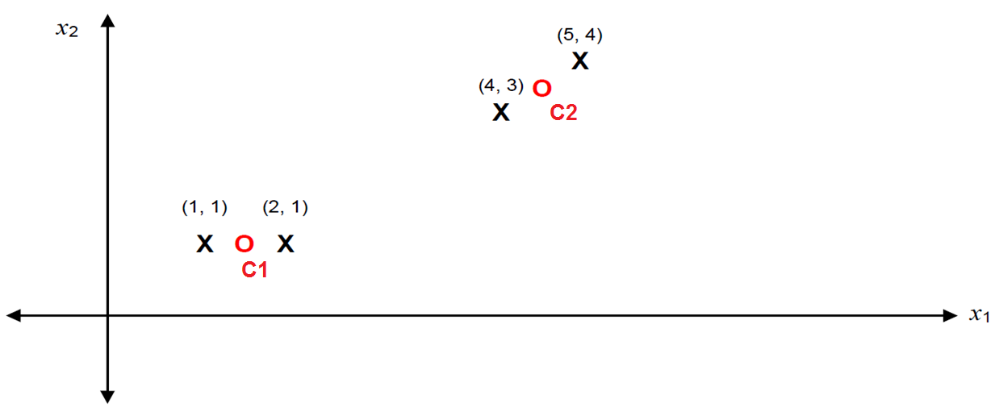
K-means clustering (cont.)
Notes:
As you see, the new red centroids represent the centers of the two clusters. The algorithm stops when the centroids do not change or change slightly, or if a maximum number of iterations are defined.

Slide 52
K-means Issues
Distance measure is squared Euclidean
Scale should be similar in all dimensions
Rescale data?
Not good for nominal data. Why?
Approach tries to minimize the within-cluster sum of squares error (WCSS)
Implicit assumption that SSE is similar for each group

Slide 53
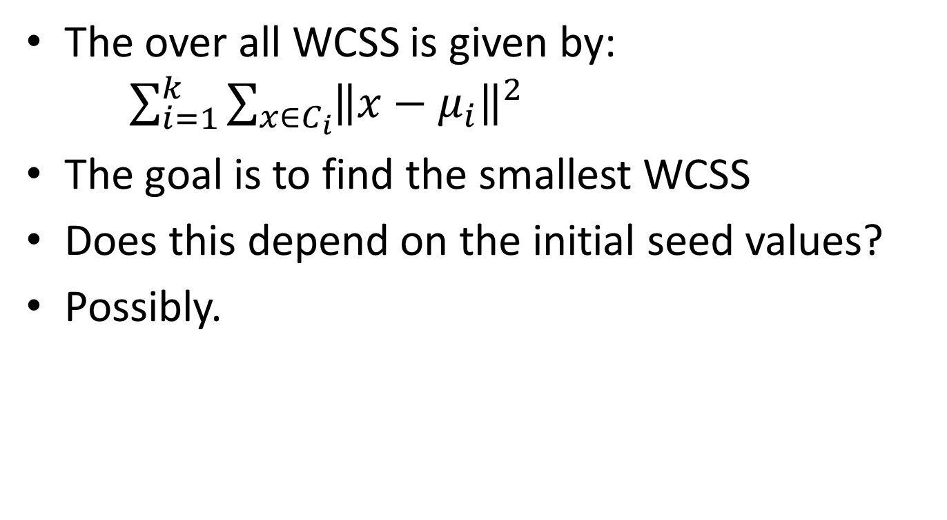
WCSS
The over all WCSS is given by: $\sum_{i=1}^{k}{\sum_{x∈C_{i}}{{\left\|x−μ_{i}\right\|}^{2}}}$
The goal is to find the smallest WCSS
Does this depend on the initial seed values?
Possibly.

Slide 54
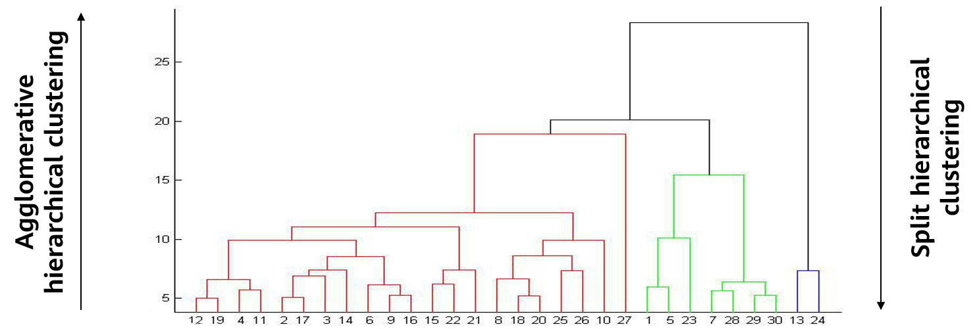
Unsupervised Learning - Hierarchical Clustering
Hierarchical clustering divides a dataset at different layers and forms a tree-like clustering structure. The dataset division may use a "bottom-up" aggregation policy, or a "top-down" splitting policy. The hierarchy of clustering is represented in a tree graph. The root is the unique cluster of all samples, and the leaves are the cluster of only a sample.

Slide 55
Machine Learning Definition
Machine Learning Types
Machine Learning Process
Other Key Machine Learning Methods
Common Machine Learning Algorithms
Case study

Slide 56
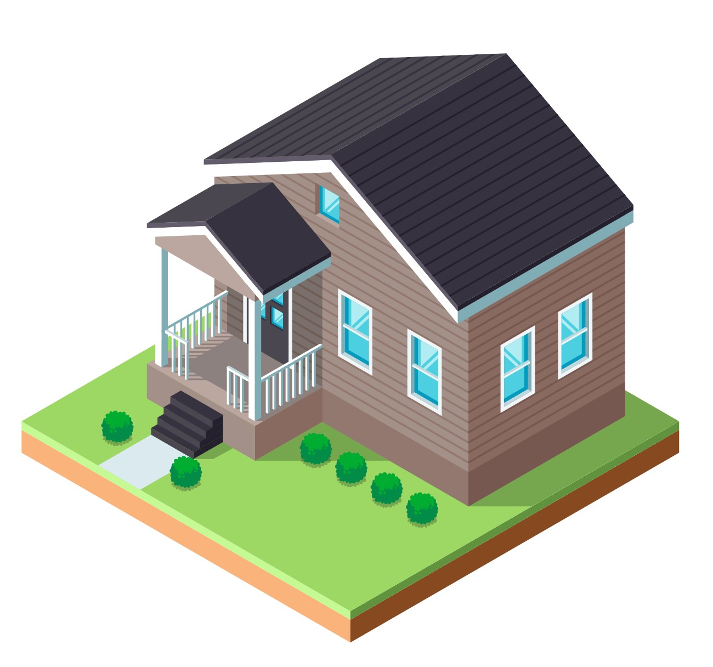
Comprehensive Case
Assume that there is a dataset containing the house areas and prices of 21,613 housing units sold in a city. Based on this data, we can predict the prices of other houses in the city.
House Area | Price
1,180 | 221,900
2,570 | 538,000
770 | 180,000
1,960 | 604,000
1,680 | 510,000
5,420 | 1,225,000
1,715 | 257,500
1,060 | 291,850
1,160 | 468,000
1,430 | 310,000
1,370 | 400,000
1,810 | 530,000
… | …
Dataset

Slide 57
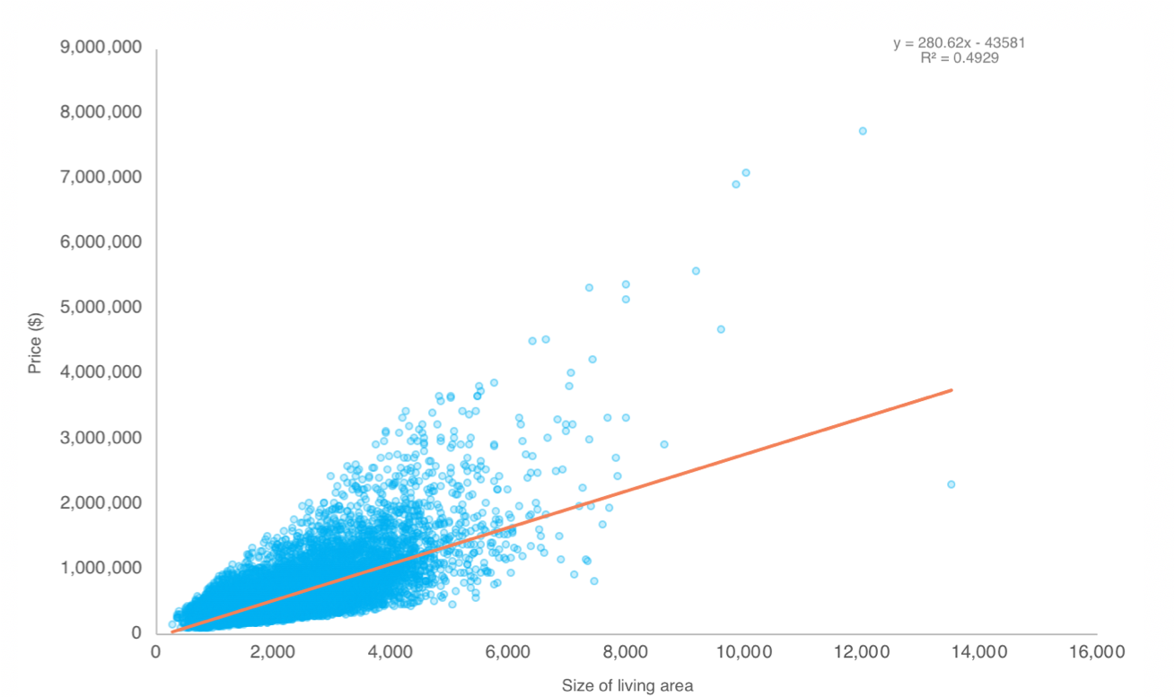
Problem Analysis
This case contains a large amount of data, including input x (house area), and output y (price), which is a continuous value. We can use regression of supervised learning. Draw a scatter chart based on the data and use linear regression.
Our goal is to build a model function h(x) that infinitely approximates the function that expresses true distribution of the dataset.
Then, use the model to predict unknown price data.
x
Feature: house area
Unary linear regression function
Input
Learning algorithm
Price
Dataset
h(x)
Output
y
Label: price
House area

Slide 58
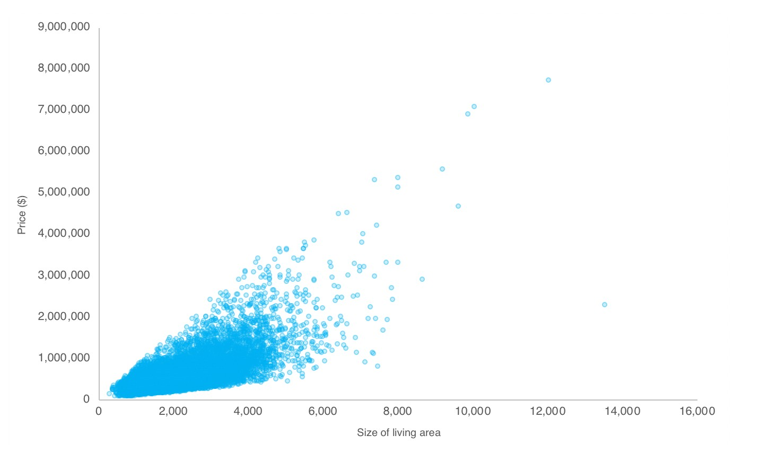

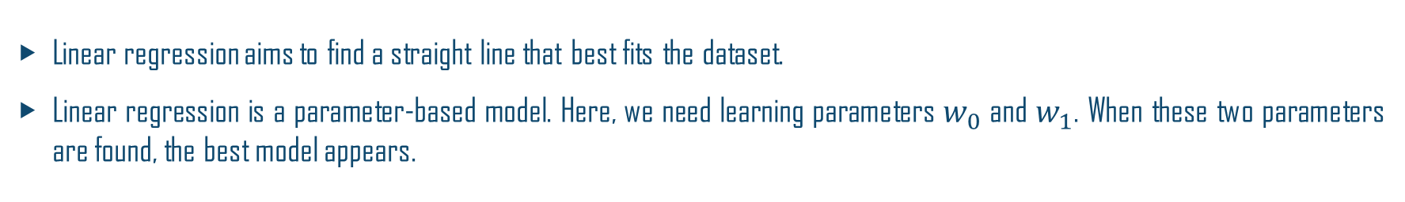
Goal of Linear Regression
Linear regression aims to find a straight line that best fits the dataset.
Linear regression is a parameter-based model. Here, we need learning parameters $w_{0}$ and $w_{1}$. When these two parameters are found, the best model appears.
Which line is the best parameter?
Price
Price
Best parameter
House area
House area

Slide 59

Loss Function of Linear Regression
To find the optimal parameter, construct a loss function and find the parameter values when the loss function becomes the minimum.
Loss function of linear regression:
Error
Goal:
Price
Error
Error
Error
where, m indicates the number of samples,
h(x) indicates the predicted value, and y indicates the actual value.
House area

Slide 60
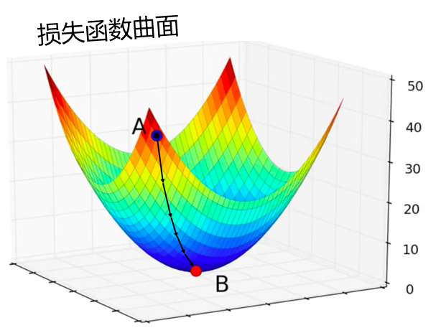
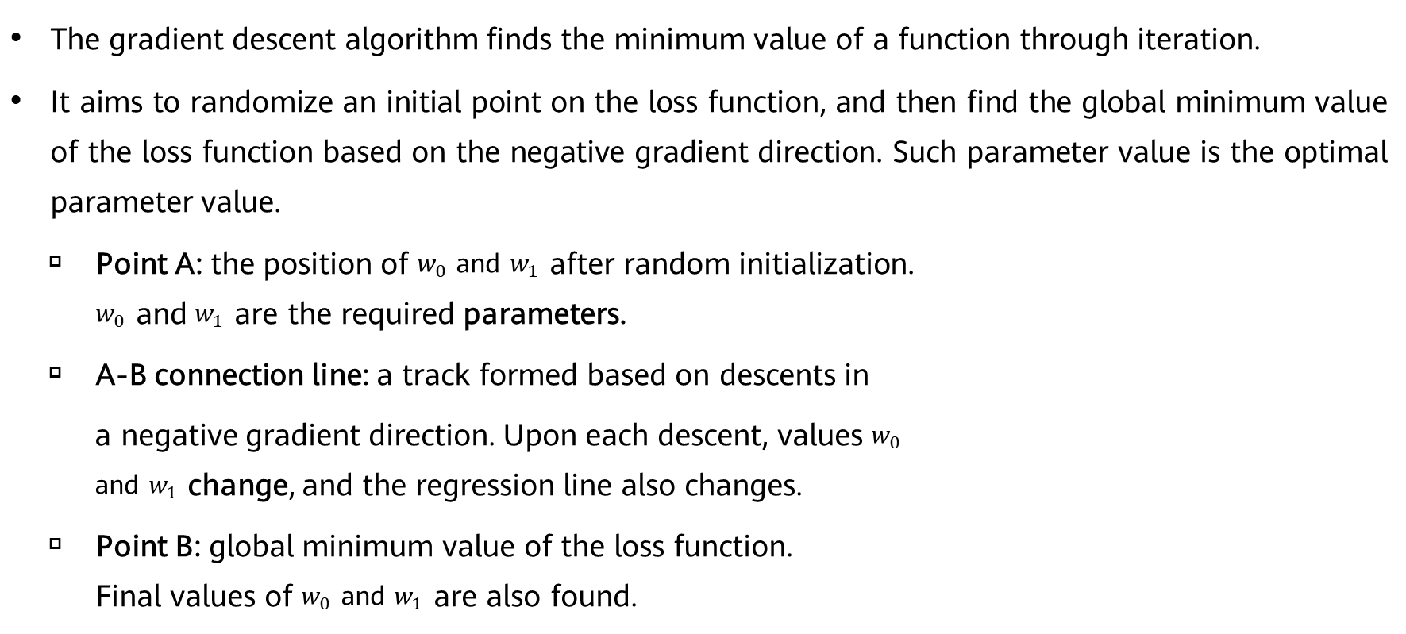
Gradient Descent Method
The gradient descent algorithm finds the minimum value of a function through iteration.
It aims to randomize an initial point on the loss function, and then find the global minimum value of the loss function based on the negative gradient direction. Such parameter value is the optimal parameter value.
Point A: the position of $w_{0}$ and $w_{1}$ after random initialization. $w_{0}$ and $w_{1}$ are the required parameters.
A-B connection line: a track formed based on descents in
a negative gradient direction. Upon each descent, values $w_{0}$ and $w_{1}$ change, and the regression line also changes.
Point B: global minimum value of the loss function. Final values of $w_{0}$ and $w_{1}$ are also found.
Cost surface

Slide 61
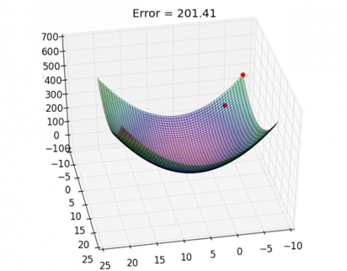
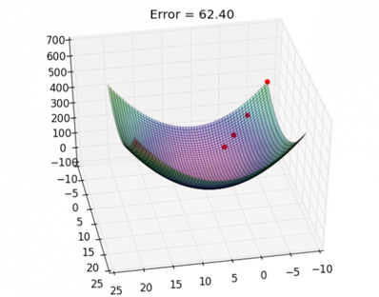
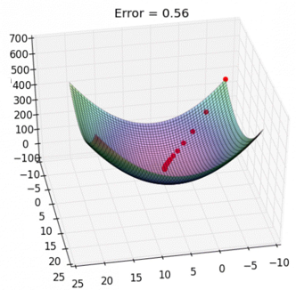
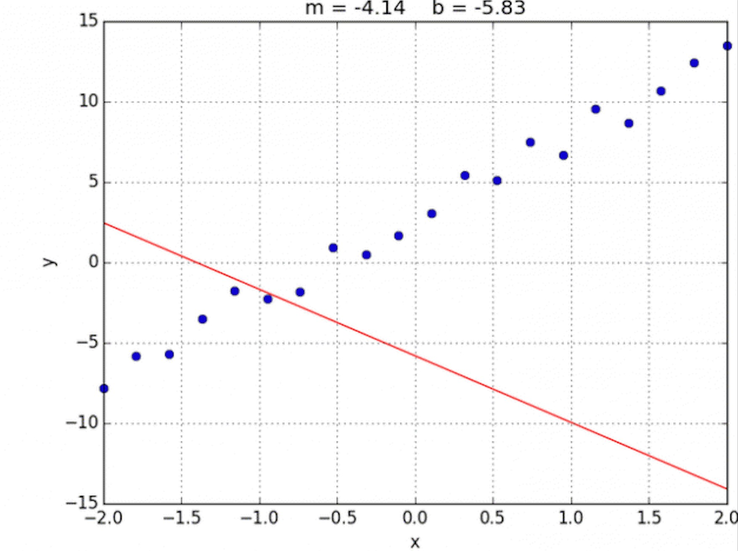
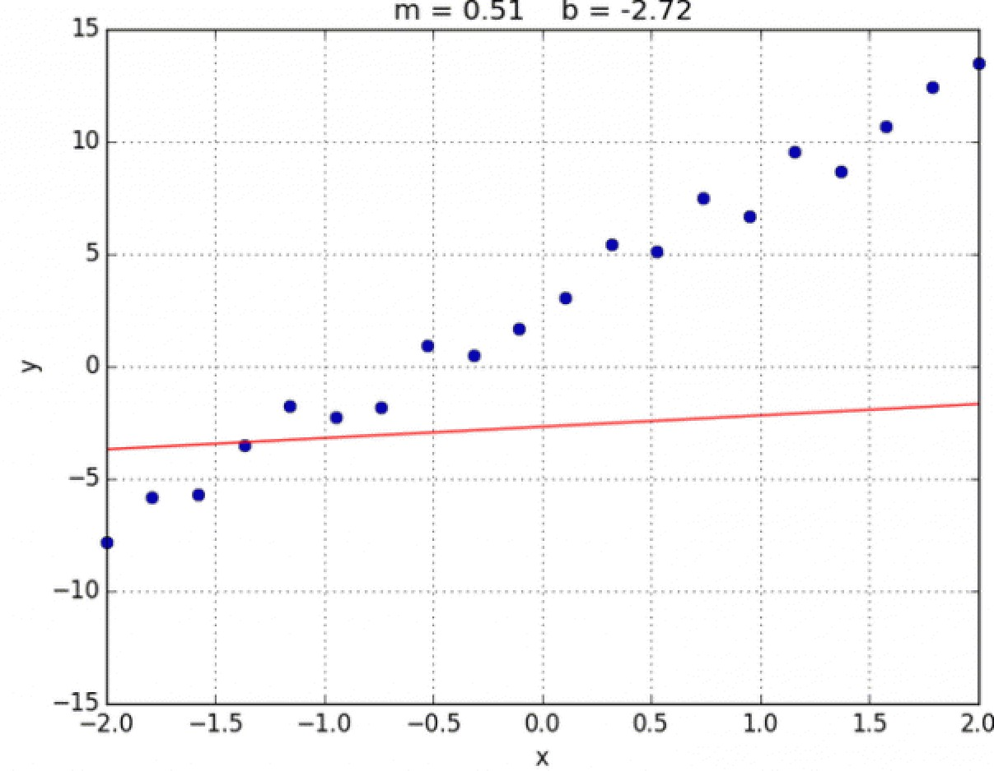

Iteration Example
The following is an example of a gradient descent iteration. We can see that as red points on the loss function surface gradually approach a lowest point, fitting of the linear regression red line with data becomes better and better. At this time, we can get the best parameters.

Slide 62

Model Debugging and Application
After the model is trained, test it with the test set to ensure the generalization capability.
If overfitting occurs, use Lasso regression or Ridge regression with regularization terms and tune the hyperparameters.
If underfitting occurs, use a more complex regression model, such as GBDT.
Note:
For real data, pay attention to the functions of data cleansing and feature engineering.
The final model result is as follows:
Price
House area

Slide 63
First, this course describes the definition and classification of machine learning, as well as problems machine learning solves. Then, it introduces key knowledge points of machine learning, including the overall procedure (data collection, data cleansing, feature extraction, model training, model training and evaluation, and model deployment), common algorithms (linear regression, logistic regression, decision tree, SVM, naive Bayes, KNN, ensemble learning, K-means, etc.), gradient descent algorithm, parameters and hyper-parameters.
Finally, a complete machine learning process is presented by a case of using linear regression to predict house prices.

Slide 64
Thanks
Any questions?

